Slide 1
👋 Hello & Welcome
⏳ This session will begin shortly.
While you wait, please download the slides for today’s session from the LevUL up website.
In association with:

Slide 2
Recording
This session will now be recorded. Any further information that you provide during a session is optional and in doing so you give us consent to process this information.
These recordings will be stored by the University of Limerick for one year and may be published on our website during that time.
By taking part in a session you give us your consent to process any information you provide during it.

Slide 3
An Introduction to Student IT Services
Kieran Murphy & Anna Marie Gildea, Information Technology Division (ITD)

Slide 4
Topics for today
Getting IT Information & Support
Password Management - Registering & Resetting Passwords
Accessing Email & Office 365
Student Printing
Accessing Wifi
Student Labs
Account Security (Phishing Awareness)

Slide 5
ITD Website & Self Service Portal addresses
www.ul.ie/itd
https://ul.topdesk.net/

Slide 6
Logging a Support Call with ITD
The Information Technology Division provide Computer Account and IT support to students. Students can raise a support call by following any of the steps below.
How do I raise a support request?
Log a support call online at: www.ul.ie/itss then select “Log a Call”.
If a student has forgotten their password, they can request a new password via www.ul.ie/itss select “Forgotten Password” and complete the online Form.
Email your Query to Service.Desk@ul.ie

Slide 7
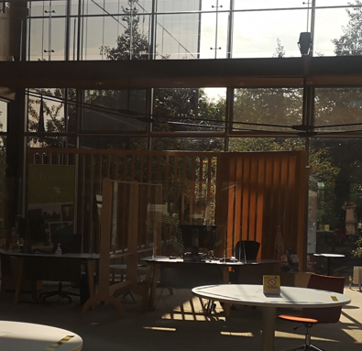
Logging a Support Call with ITD
The ITD Service Desk is located in the Foyer of the Glucksman (next to the Library Information Desk)
If you need assistance in person, we can be found here.

Slide 8
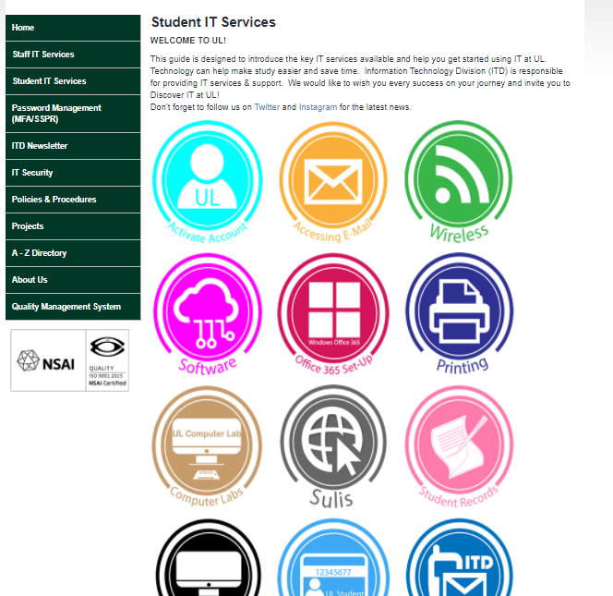
Quick start Guide for students – www.ul.ie/itss
This Year we have changed the Format of the Quick Start Guide. Instead we have developed a more interactive Website introducing IT Services to students. Here you will find all that is required to initially get started including video “How to” content.
Student IT Services | University of Limerick (ul.ie)

Slide 9
Password Management including Self Service Password Reset and Multifactor Autentication - MFA
MFA & SSPR has been implemented and rolled out to all staff and students.
A UL account is required to access IT services provided by UL, e.g., Email, Sulis, Microsoft Teams & OneDrive for Business. An account consists of a username and a password, and for security reasons, Multifactor Authentication (MFA) is required to access IT services from home / off-campus.
Self-Service Password Reset (SSPR) enables you to reset your UL computer account password (e.g., your UL email or Sulis password) anywhere anytime without the need to contact our Service Desk.
You will need to Activate your Account before you can access IT Services by doing the following:
Register for Multifactor Authentication (MFA) & Self-Service Password Reset (SSPR)
Change your initial password.
If you studied in UL in the last year: You may still have an active student computer account. If that is the case you should use your old password If you remember it, otherwise you SSPR to reset your password.
More information can be found here Password Management | University of Limerick (ul.ie)

Slide 10
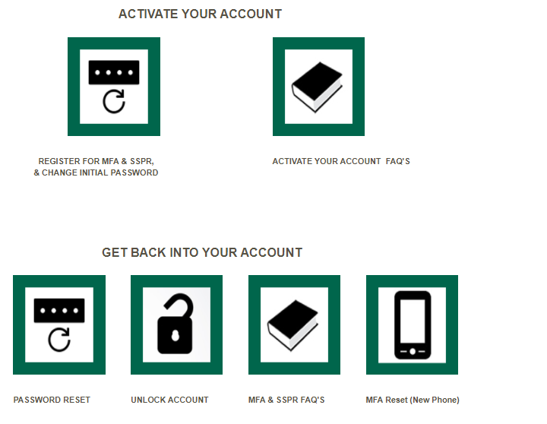
Password Management – Password Management | University of Limerick (ul.ie)

Slide 11
Visit https://portal.office.com to access you UL student email.
The format of your email address is StudentID@studentmail.ul.ie .
For security reasons you will not be able to access your email if you have not Activated your UL Student Account
Access Email
Office Apps - Word, Excel, PowerPoint, Teams, etc
Cloud Storage - OneDrive

Slide 12
​Office 365 Apps - UL Students can download and install Microsoft Office 365 (Microsoft 365 Apps) on 5 different devices including laptops and mobile devices.

Slide 13
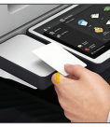
Student Printing
ITD have implement a ‘Follow Me Print’ service. You can print, copy and scan documents at any Multi-Function Printer (MFP) located throughout the campus.
You have the option to print in black & white or colour (choose this option before sending your document to print). Printers queues are clearly identified as ‘Black & White’ or ‘Colour’. You will need to have print credit on your account to print as there is a charge for printing.
The print jobs are submitted to a release queue and you can visit any MFP to release and print your job.. You’ll only be charged once you have released the print job.
Online Print Submission
Submit print jobs online at https://secureprint.ul.ie and release at any student printer anywhere on campus, using your ID card or computer account. You’ll only be charged once you have released the print job.

Slide 14
Student Printing Contd.
To Purchase Print Credit :
Online: You can purchase print credit online at https://ulprint.ul.ie Purchased print credit will be
immediately added into your account
Scan to Email :
Scanning is free of charge, and scans can only be sent to your own studentmail.ul.ie email account.

Slide 15
Wi-Fi – Connecting to Eduroam
What is eduroam?
eduroam is a secure international roaming infrastructure. It is used by affiliated educational facilities to allow their staff and students to access wireless services on their home institute and also visit other participating institutions and continue to have wireless connectivity by simply using your personal credentials (i.e. username and password) assigned to them by their home institution. The wireless name is the same in all places “eduroam”. The eduroam service grants different levels of access depending on if you are a staff member, a student or if you are an eduroam user from another Institution. This system greatly enhances security and all WIFI on campus will now be authenticated and encrypted.
How do I get connected to Wireless?
All students will connect to the wireless network “eduroam” which is available throughout the campus.
Further details available at www.ul.ie/itss

Slide 16
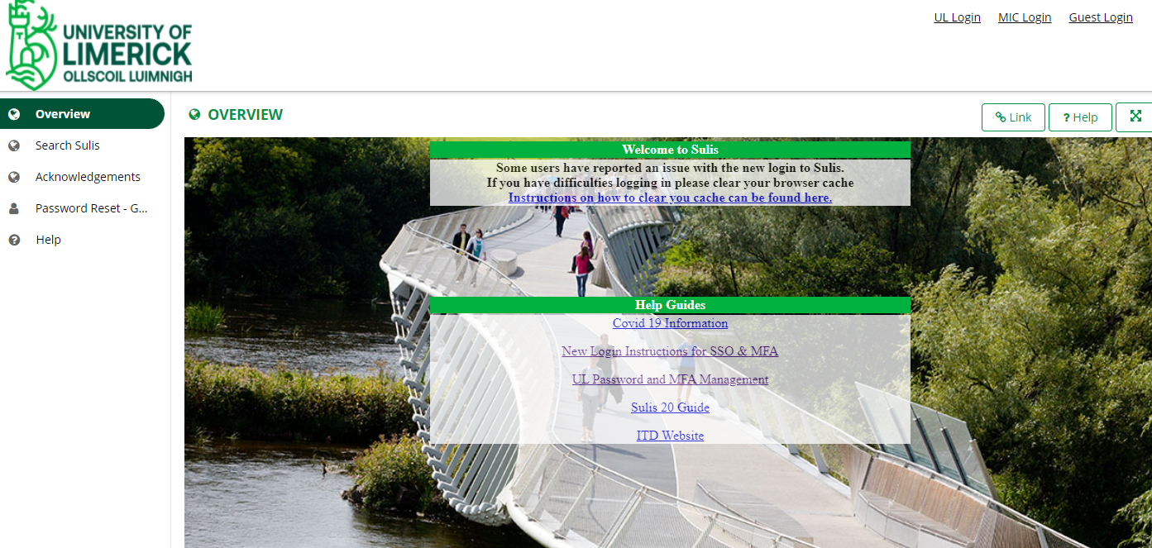
Sulis
Sulis is the University’s Virtual Learning Environment.
URL: https://www.sulis.ul.ie
Access this year has been changed to single sign on and MFA.
Sulis is used to share content and facilitate online learning in UL.
Lecture Content (Videos, Podcasts, Slides, Notes, readings, etc)
Assignments
Online Classes through BigBlueButton
Forums
Grading and Feedback
Each Lecturer will have their own teaching style so be sure to check with them on how they will use Sulis in their module.

Slide 17
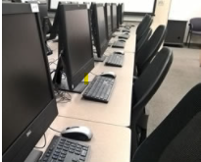
ITD Student Labs
There are a number of Student Computer Labs on campus. The
locations and opening hours for these labs are available at
www.ul.ie/itss
Opening hours are subject to change during the semester. In the
Library this is dependent on the Library opening times
You can check here for Computer Lab Availability in real time.
There are 4 hour laptop loans available from the Library
Laptops can be borrowed for up to 4 hours. There is no charge to borrow a laptop; you just need your UL Student ID card. Fines will apply for late returned, lost, stolen or damaged laptops. Please wipe down laptops before and after use.
For further information please go to Borrow a laptop | Glucksman Library (ul.ie)

Slide 18
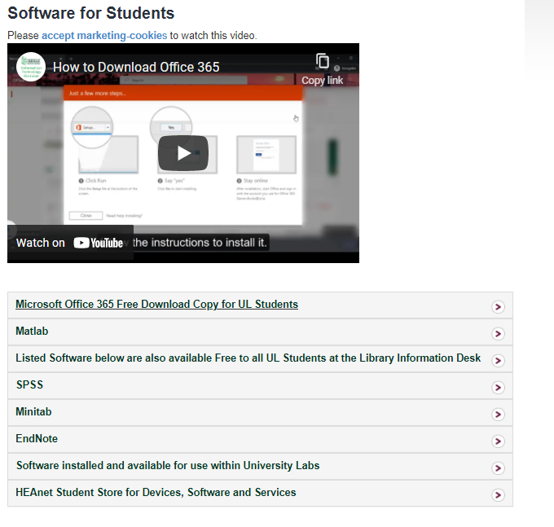
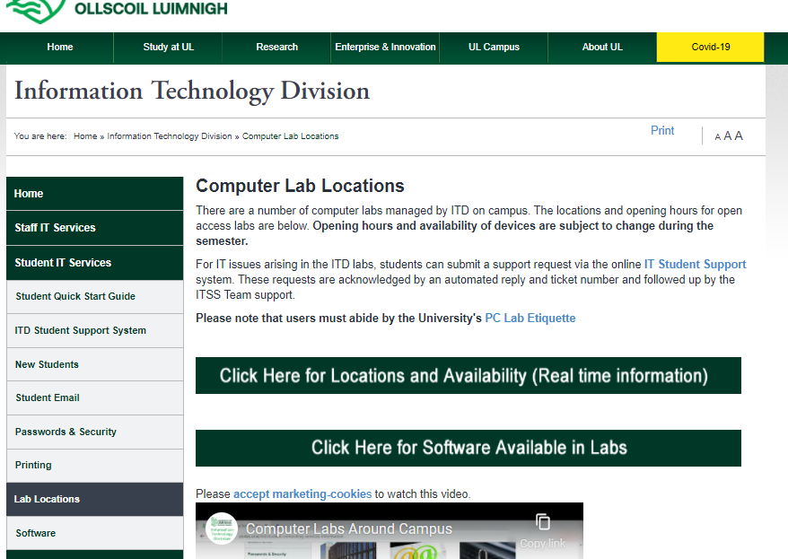
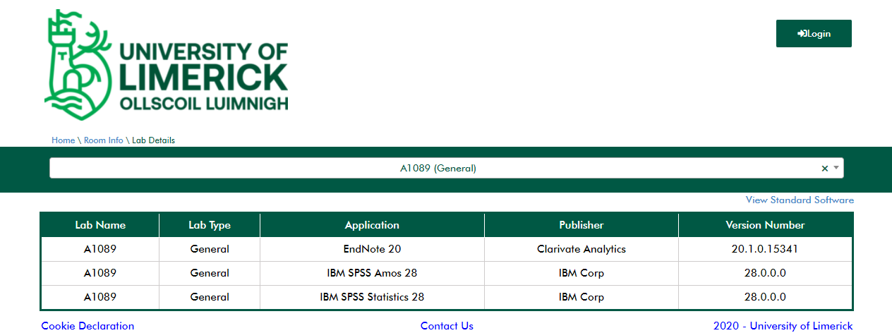
Software available from ITD
ITD offer a range of academic software that can be accessed in several different ways. More information can be found on Software for Students | University of Limerick (ul.ie)
Software available on Student lab PCs can be viewed on the Student section of the ITD Website https://ulsites.ul.ie/itd/computer-lab-locations. You can check which labs have the software you require installed.

Slide 19
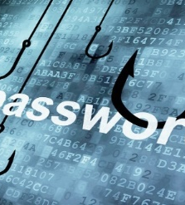
Phishing Awareness
Phishing attacks can take many forms, but they all share a common goal – getting you to share sensitive information with a third-party
Do not share your Student Account Password with anyone
Be careful of emails requesting you to verify your login details. ITD will never ask you to do this over email
Do not click on links or attachments from senders that you do not recognise
Do not provide any sensitive personal information over email
Watch for email senders that use suspicious or misleading domain names
If you are unsure an email is legitimate DO Not Open It! Contact ITD at the earliest opportunity
More information can be found on www.ul.ie/itd and from there click on the IT Security Menu

Slide 20
Phishing Awareness
Security Awareness

Slide 21
ITD Social Media and Video Support Content

Slide 23
Raise a ticket by logging a call at https://ul.topdesk.net
If you have any issues, please contact ITD (Information Technology Division). Tell us as much information as you can i.e., location, room, device, software and version etc. This will help us to improve our service to you.

